Slide 1


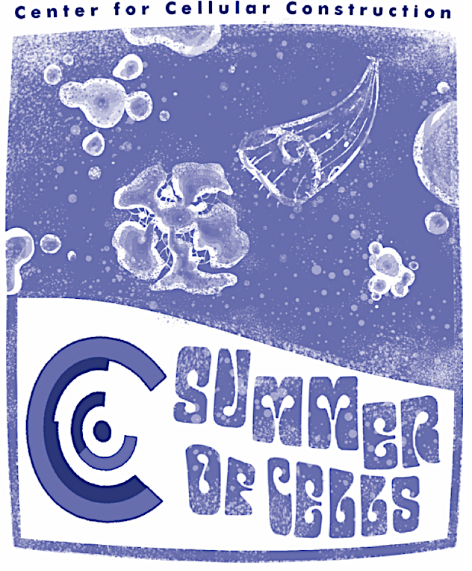
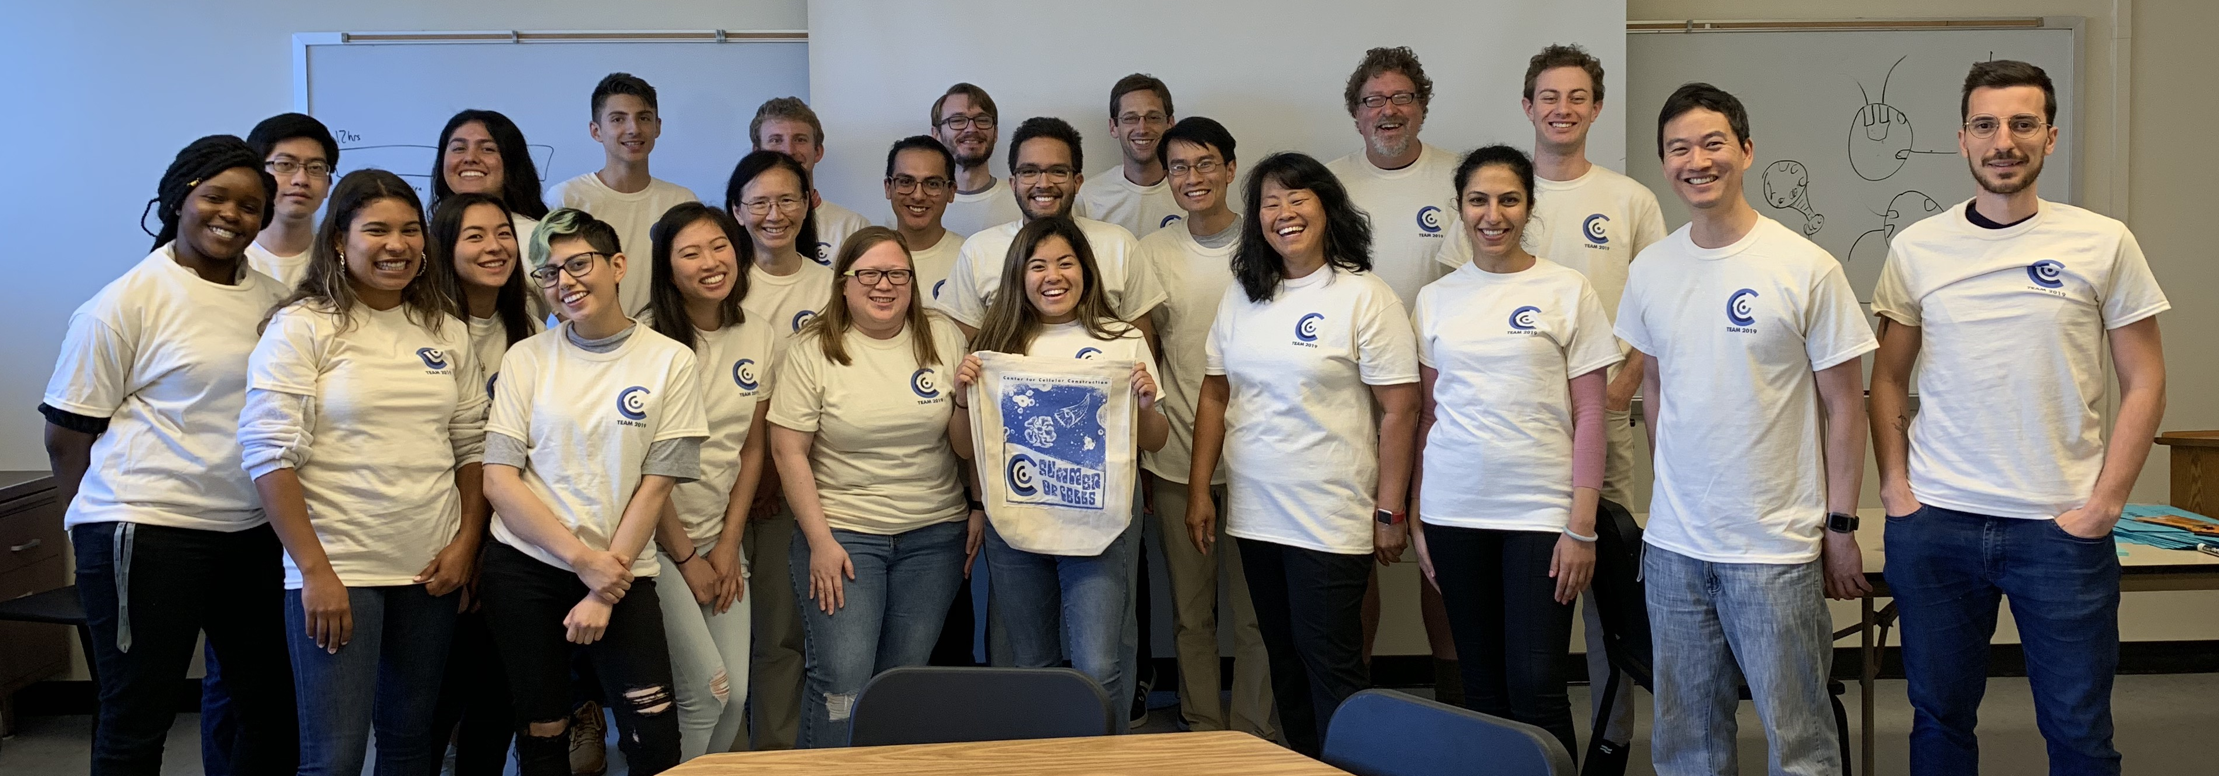
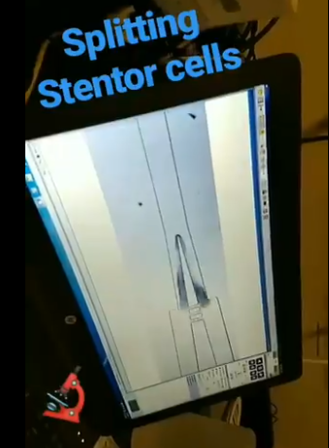
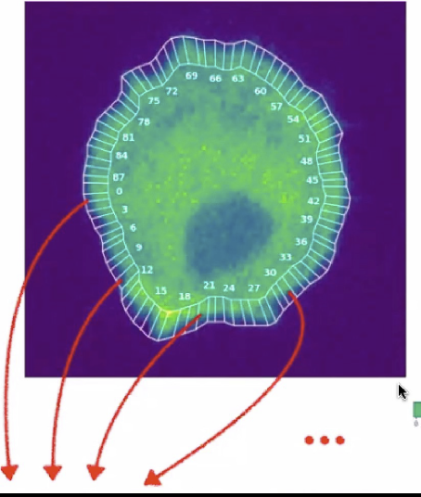
The 2022 CCC Summer
Cellular Engineering IN PERSON Workshop
July 18-29, 2022
What we do:
-Work in interdisciplinary and inclusive teams
-Develop and deploy cell biology, programming, and engineering techniques
-Learn how cells work, solve novel biological problems, produce useful compounds.
-Practice #scicomm presentation skills
Potential Project Themes:
-How can we design and
remodel tissues?
-How do single cell organisms make decisions and solve problems?
-Can we develop new techniques in cellular engineering?
We need YOU!
-Leaders: Develop collaborations, test new ideas, get data, strengthen mentoring skills
-Participants: Undergraduate, Master’s, and PhD students from all CCC labs
Interested? Contact Diana Chu (chud@sfsu.edu) or Mark Chan (yhmchan@sfsu.edu)

