Slide 1


Lightning Talks CCC Retreat Aug 10, 2022
This work is funded by the National Science Foundation (NSF) grant No. DBI-1548297.
Disclaimer: Any opinions, findings and conclusions or recommendations expressed in this material are those of the authors and do not necessarily reflect the views of the National Science Foundation.

Slide 2
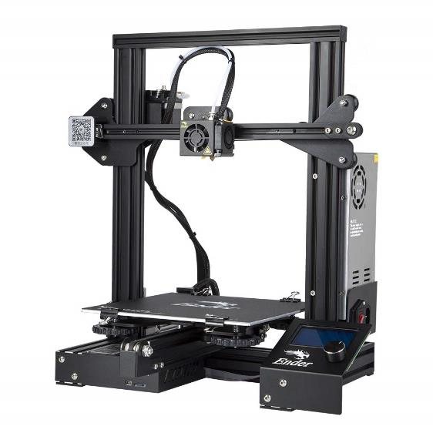
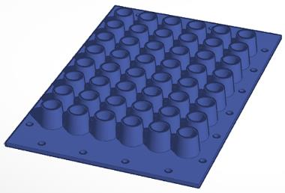
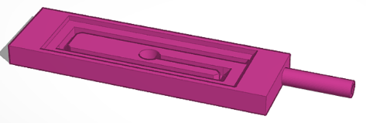
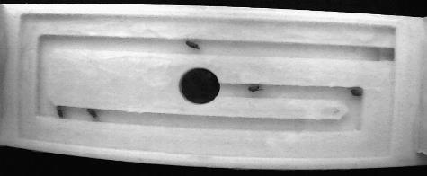
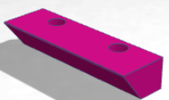
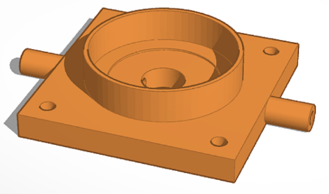
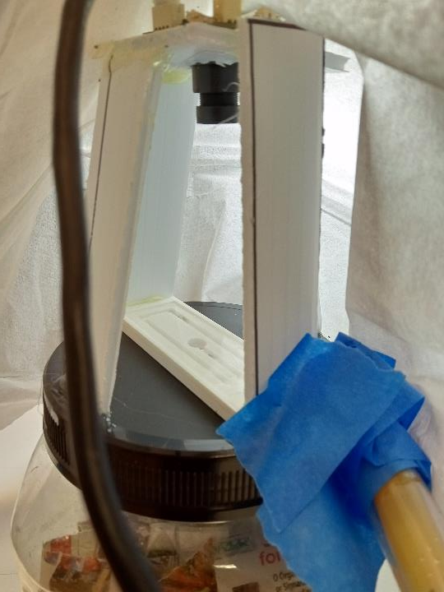
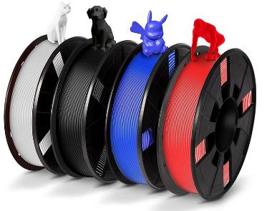
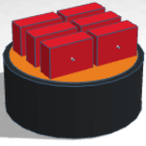
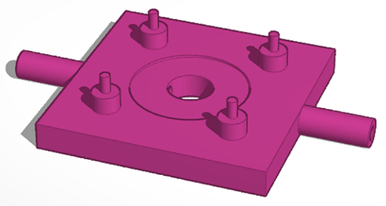






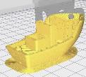

3D Printing for High Throughput Biological Research
Fly Cup - UCSF/IBM
Fly Maze – IBM/SFSU
Fly Maze
HD USB
Video
Camera
Creality Ender 3 <$200
DAM Holder – IBM/CSU-EB
Holo Flow Cell - IBM/SFSU
15” Speaker
Fly Maze
Printer Filament $25/kg
Holo Flow - IBM/SFSU
DAM Shaker - IBM/CSU-EB
Exit Tube
Fly Container

Slide 3
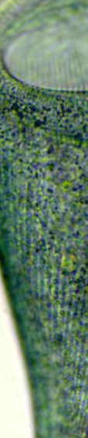
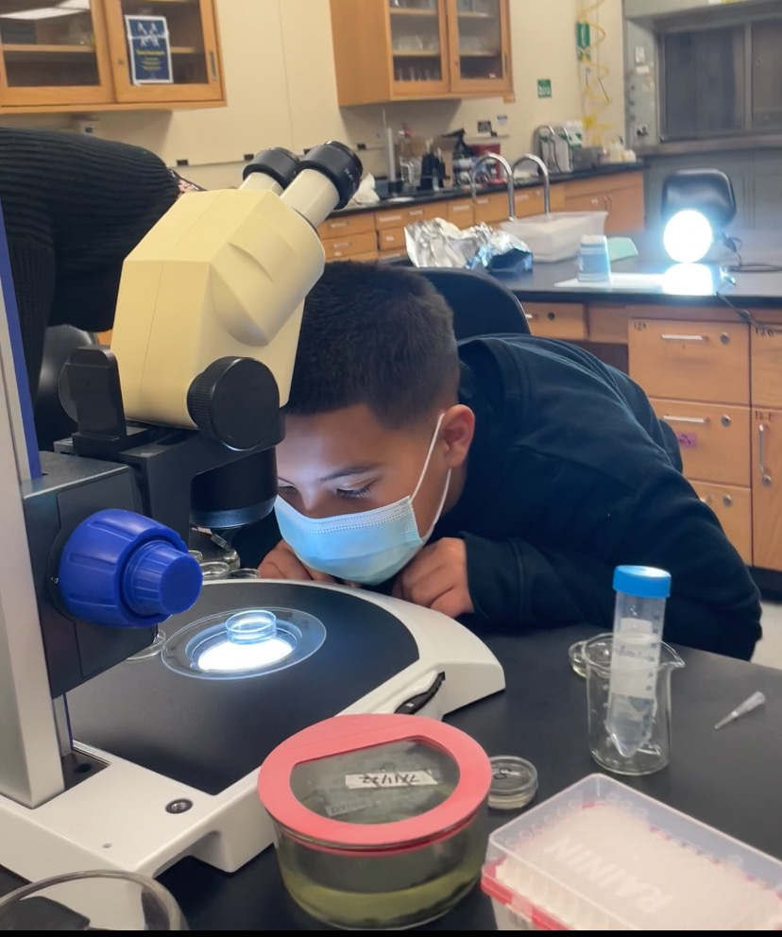
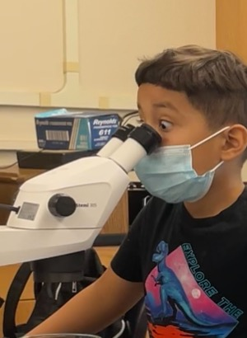
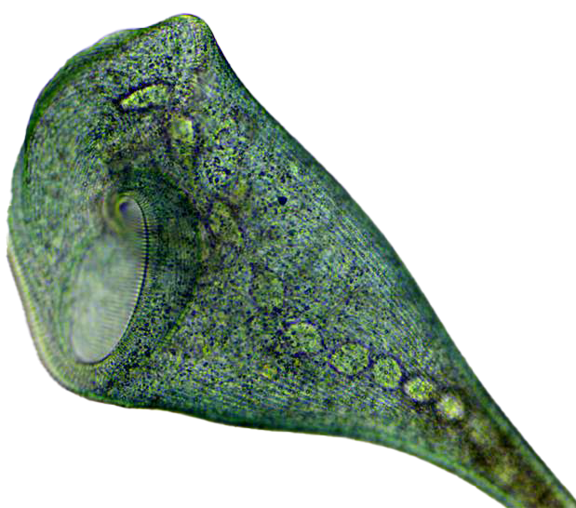
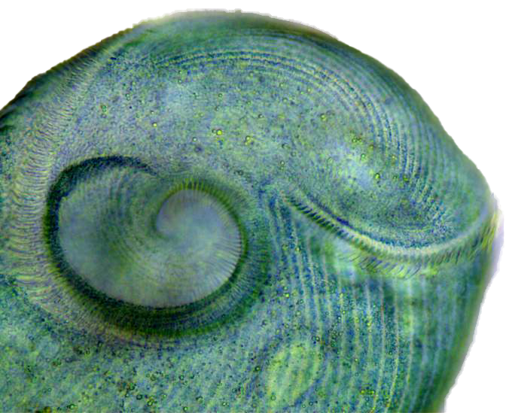
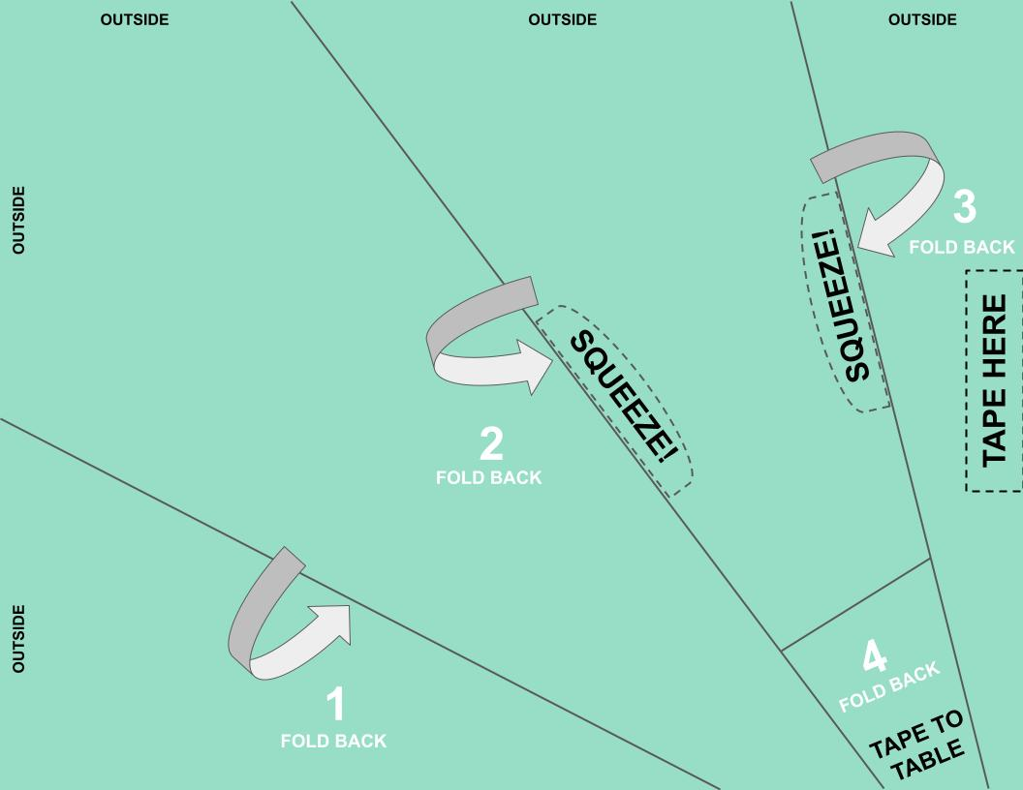
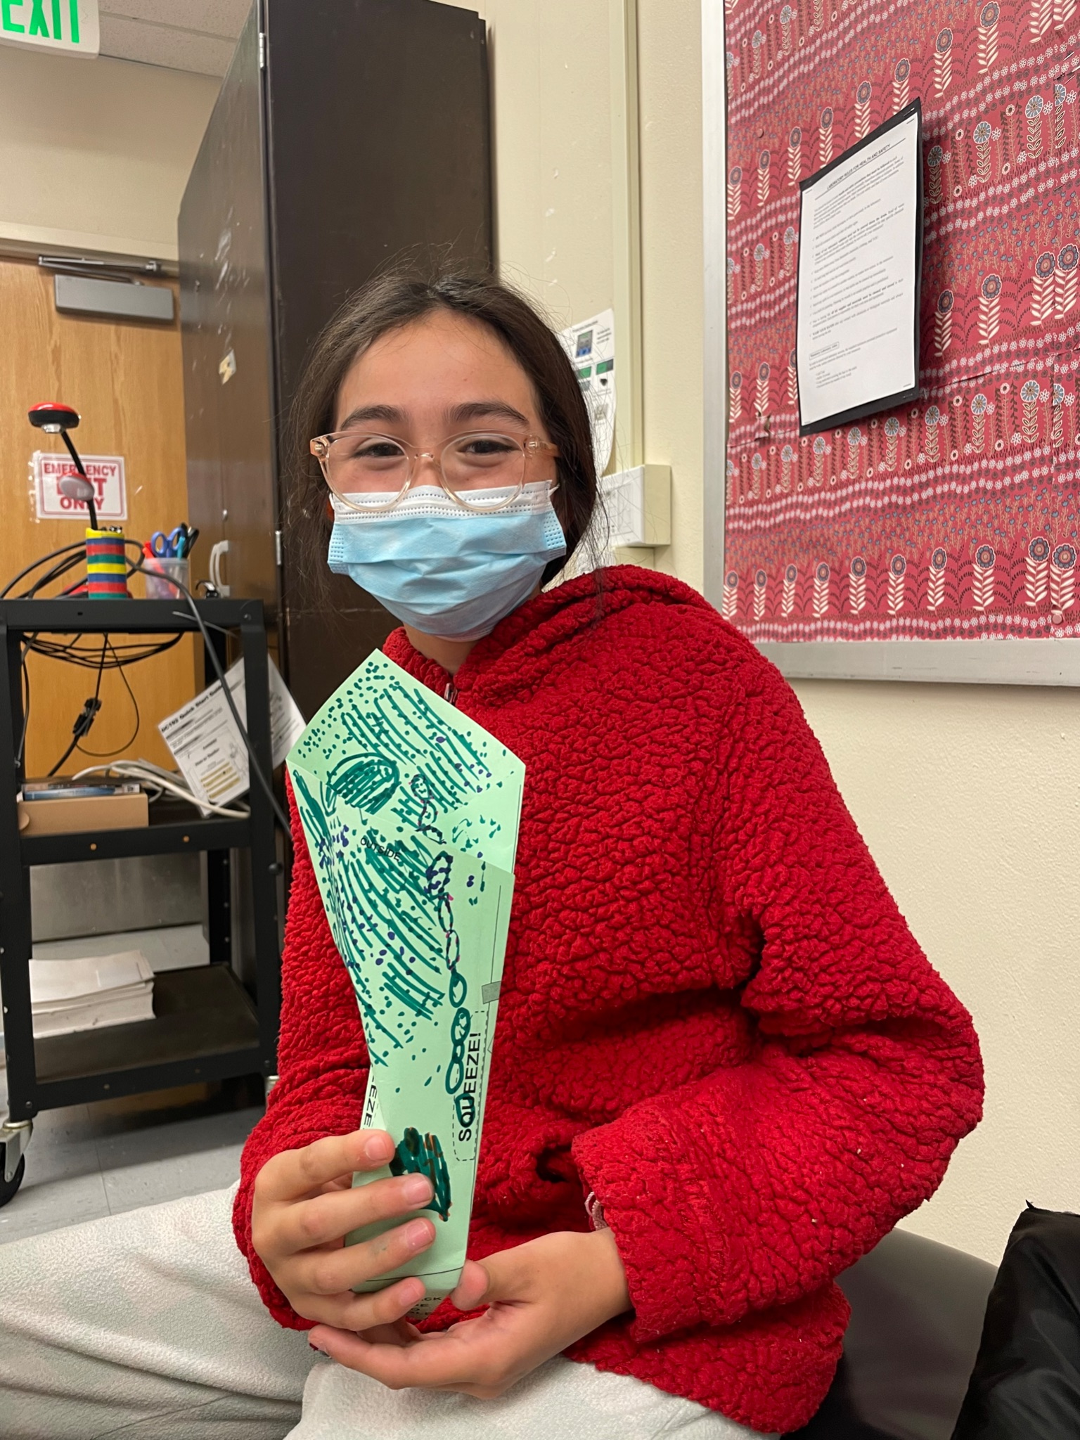
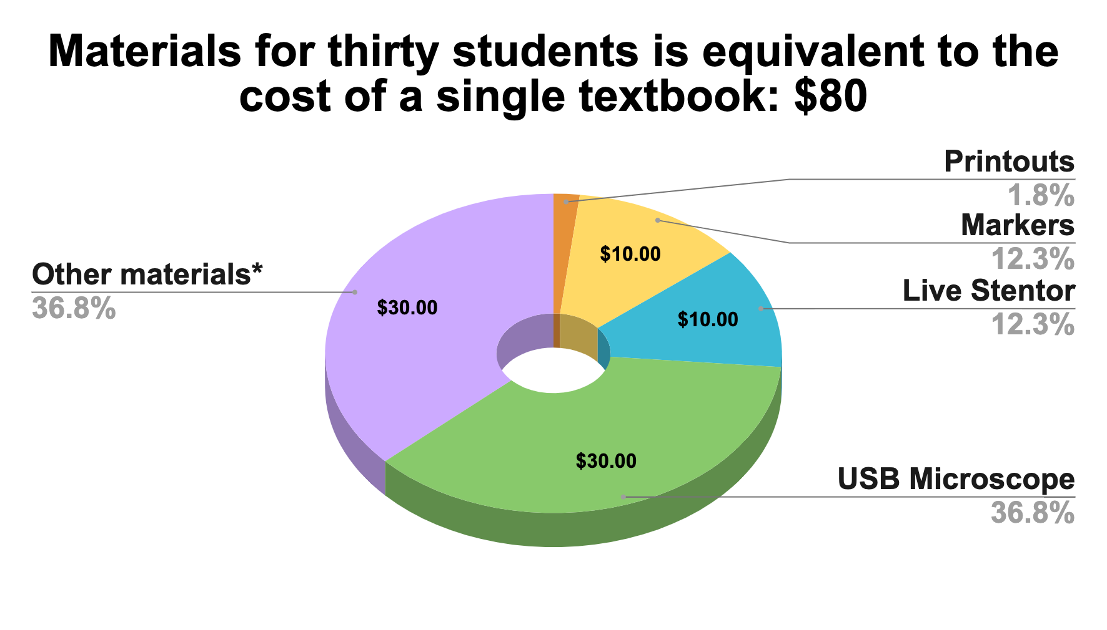
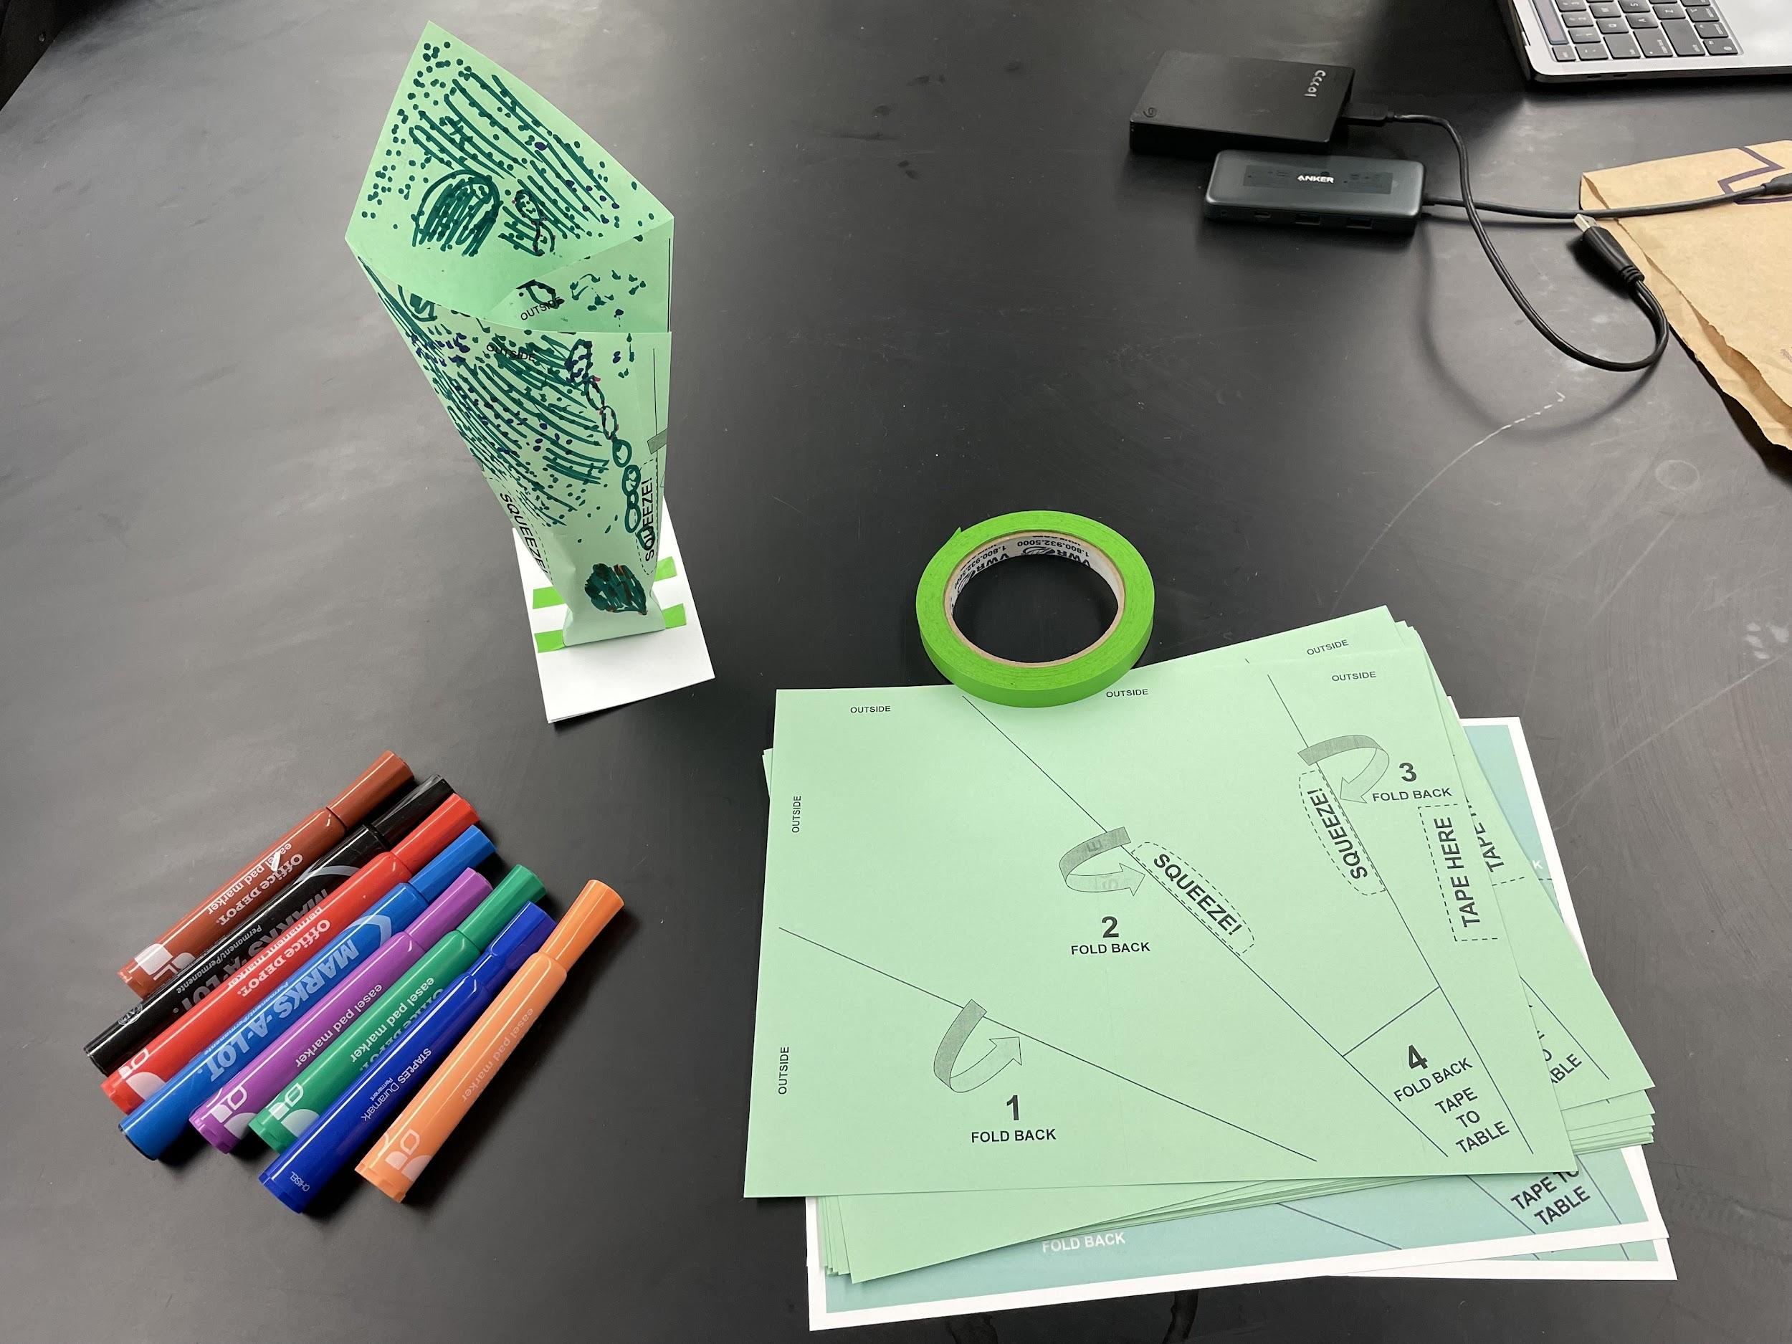
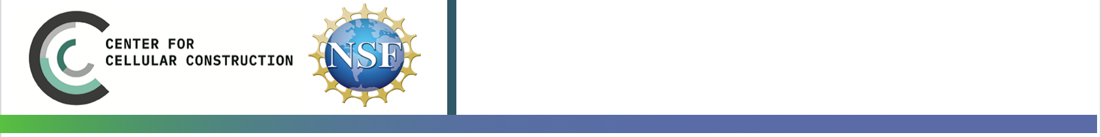

Stentor in Every School
We plan to use Stentor coeruleus as a hands-on educational tool to
help K-12 students explore the wonder and beauty of nature
Lilibeth Acuna, Kathya Correa Almanza, Alex Bonville, Brenda Garibay, Deepa Rajan, Eric Tang, Megan Voss, Wallace Marshall
Section of Stentor coeruleus
200x magnification
Introduction
Science is not taught as part of the official curriculum in some first grade classrooms in the South San Francisco Unified School District. The only science students learn are embedded in the curriculum of other subjects.
Teachers receive little to no support in implementing science learning in their classroom.Teachers are expected to either adopt science units from external sources or come up with something entirely on their own for their class.
Stentor are a gateway for students to explore the natural world in a hands-on way
Phase 1: Initial Testing
Create a short course to introduce students to topics in Biology & Engineering using
Stentor coeruleus
Partner with local teachers to implement this course in a classroom
Survey students to assess the effectiveness of this course in promoting science engagement
Phase 2: Larger Scale Implementation
Revise course based on feedback from students and teachers
Implement this course in a larger number of classrooms
Assess findings to ensure continuity of Stentor in Every School
Why Stentor coeruleus?
Students can easily see Stentor since they are giant single cells (~1 mm extended)
Stentor can learn without a brain or nervous system
Stentor regenerate following injury
Stentor can introduce students to the concept of single cells
Stentor are beautiful and show that cells are much more than simple bags of chemicals!
Expected Results
Increased student engagement and community in STEM with diverse representation of what scientists can look like and study
Enriched science collaboration, curiosity and wonder in the K-8 students attending SFUSD schools
Before and after surveys increasing their positive relationship with science once completing the course
Left: Student observing Stentor coeruleus in a petri dish with the naked eye. Right: Student observing Stentor coeruleus through a dissecting microscope.
Stentor can inspire creativity and imagination within students
What Is Needed Moving Forward
Collaborations with CCC leadership to ensure that our work aligns with the core mission of the CCC and to create a stable, self-sustaining infrastructure for this program.
Join established partnerships with schools to implement course
Opportunities to increase public visibility
Partnerships with programs to help recruit student volunteers
Partnerships with organizations for logistical solutions
Funding for Stentor kits for schools
Stentor coeruleus extended
Images by Flupke59. Wikimedia Commons
‘Mouth’ of Stentor coeruleus
Acknowledgements
This material is based upon work supported by the Center for Cellular Construction, which is a Science and Technology Center funded by the National Science Foundation (DBI-1548297). The Student Enrichment Opportunities (SEO) office supported the printing of this poster. We would also like to thank Debra Singer, Mark Chan, and Diana Chu.
*Other materials include: spring water, containers for live Stentor, etc.
Left: Student holding a paper model of Stentor coeruleus that she created.
Top Right: Diagram for printable paper model of Stentor coeruleus.
Lower Right: Materials needed for students to build their own Stentor.
Notes:
Link to Docs/Notes: https://docs.google.com/document/d/19ylyqlurKIlnnhgdJ5gOf5_Ml3qrcRdLbvTRsnwtmoI/edit?usp=sharing
Stentor are a gateway for students to explore the natural world in hands-on way
Assess findings to ensure continuity of Stentor in every school
Our Stentor in Every School initiative can quickly bring hands-on science learning back into to classrooms and create a lasting framework for future experiential learning workshops
designed by students, for students.

Slide 4
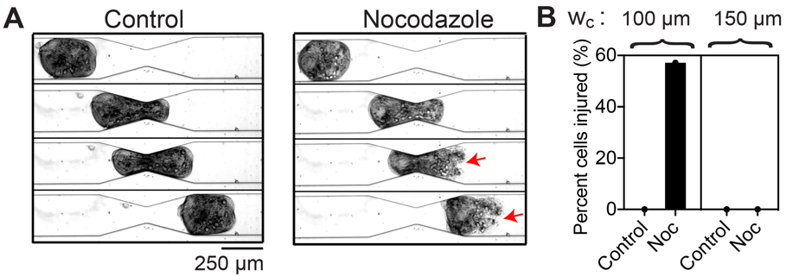
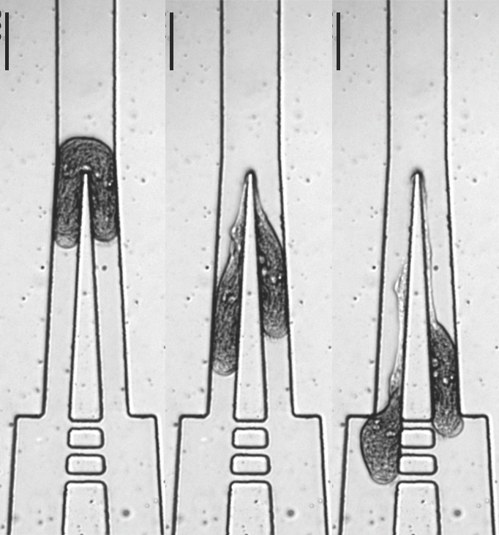
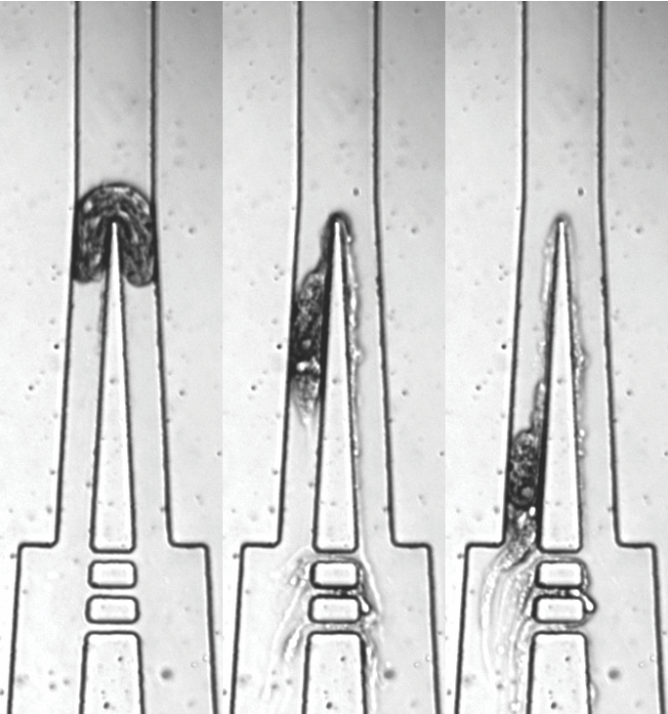




































The role of a robust cytoskeleton in Stentor wound resistance & healing
Wound healing
Excellent wound healing
Ability to resist wounds
Regenerates from a tiny fragment
Mechanical healing
Biochemical healing modes
Survives bisection
200 µm
Pond-dwelling unicellular ciliate, Stentor coeruleus
Contraction
Pulling
Twisting
& pulling
Cytoplasm retrieval
Eg. Vesicle patching
Techniques: microfluidic wounding, RNAi and small molecule inhibitor disruption of cytoskeletal elements
Role of cytoskeleton in wound resistance
Role of cytoskeleton in wound healing
Future directions
Control
Septin-like RNAi
Cytoskeletal basis of mechanical and biochemical modes
Engineering wound resilience capacities in artificial cells
KD of septin-like protein impairs cell survival post bisection
Septin-like protein preserves cell integrity while cutting
Disruption of microtubules reduces cell’s capacity for wound resistance
through a microfluidic constriction chamber
Ambika V. Nadkarni, Kevin S. Zhang, Wallace F. Marshall & Sindy K. Y. Tang (Tang lab, Stanford & Marshall Lab, UCSF)

Slide 5
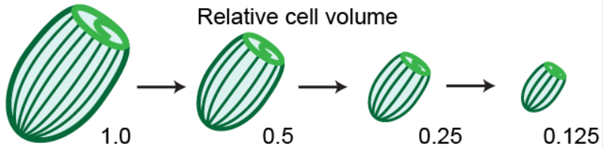
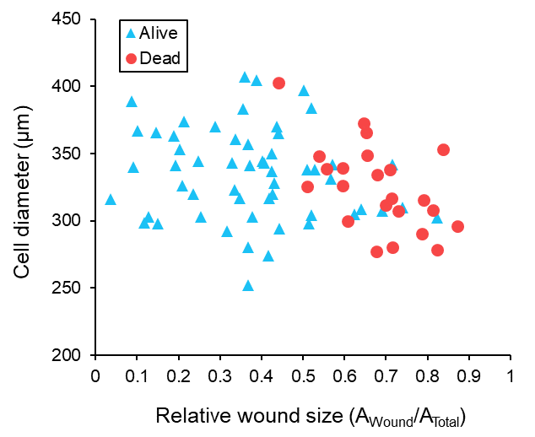
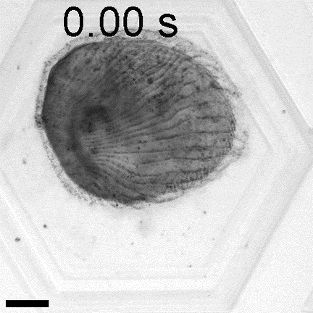
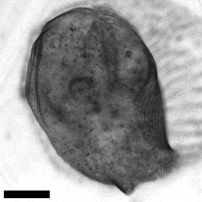
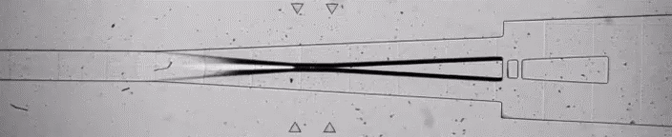
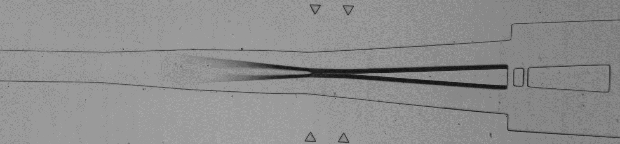
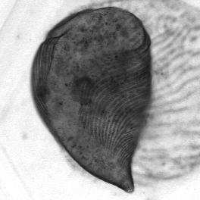
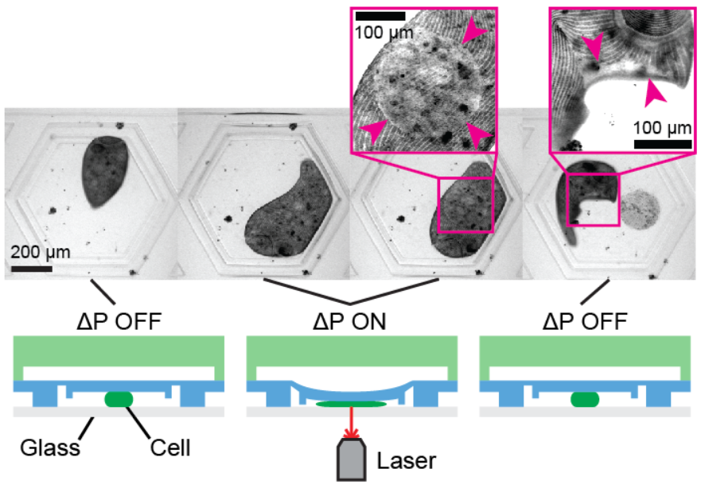
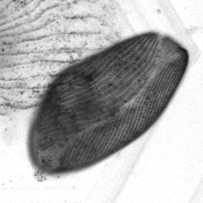
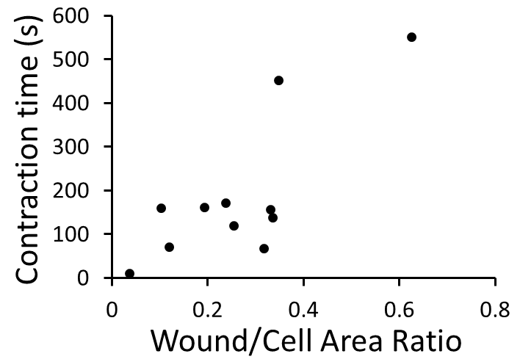
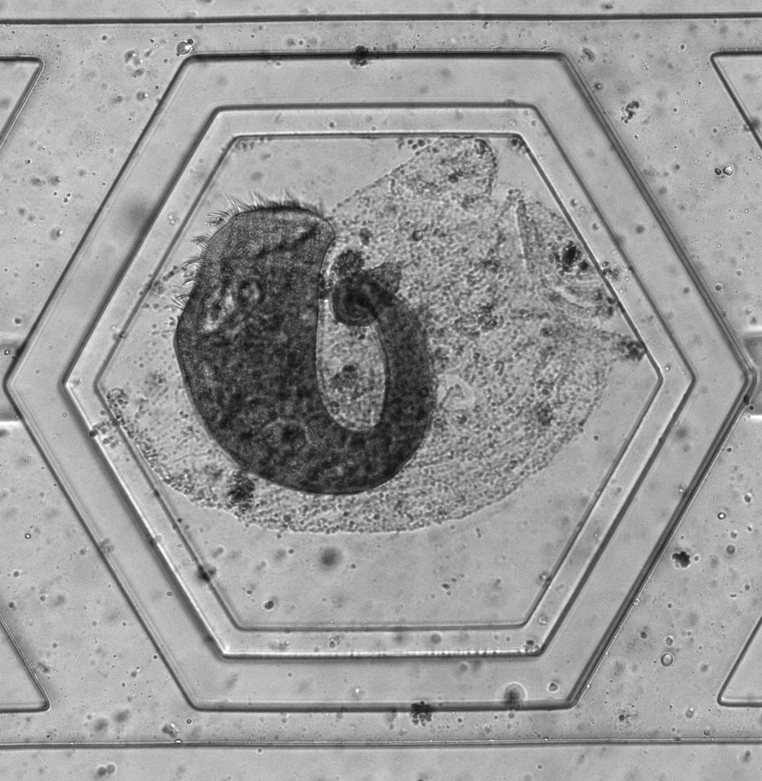
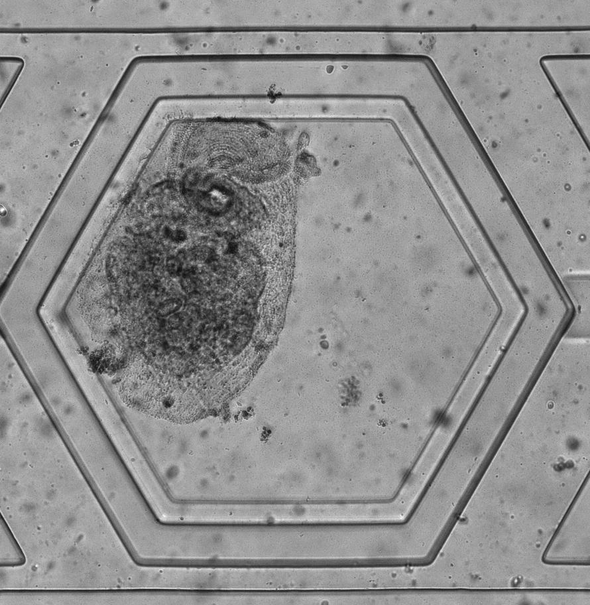



Wound repair dynamics in Stentor coeruleus depend on cell size and wound size
Cell size is controlled via serial bisection
Our platform can identify critical wound size limits for successful repair
During wound repair, Stentor utilize contraction at wound
size-dependent timescales
Full size cells (relative volume 1.0) have reduced survival at >50% membrane loss
40 s
200 μm
100 μm
101 s
200 μm
Wound size is controlled via laser ablation
100 μm
266 s
Alive
Dead
200 μm
Kevin S. Zhang, Ambika V. Nadkarni, Martín Koch, Rebecca McGillivary, Wallace Marshall, and Sindy K. Y. Tang

Slide 6




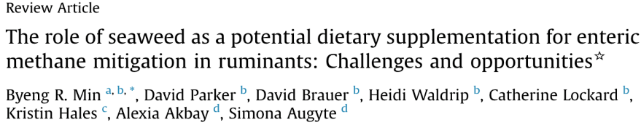
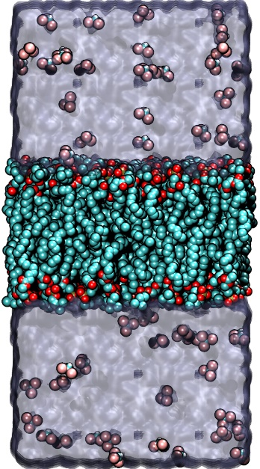
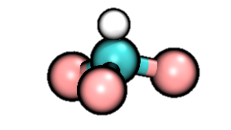
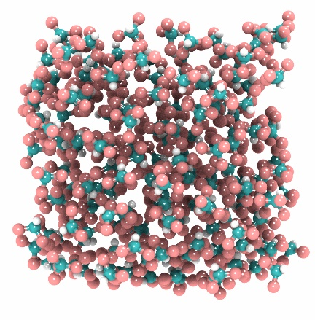
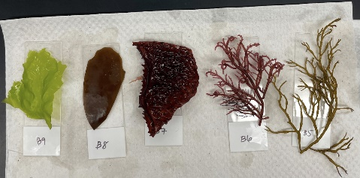
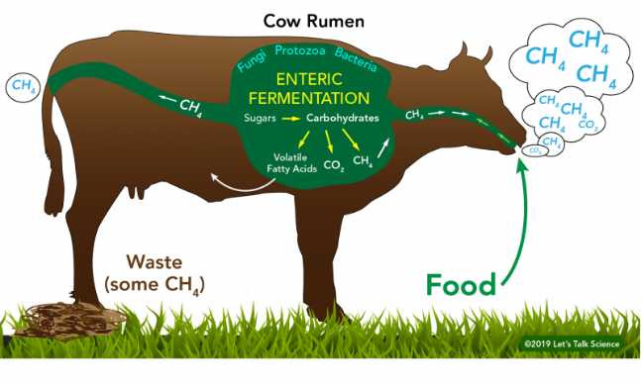
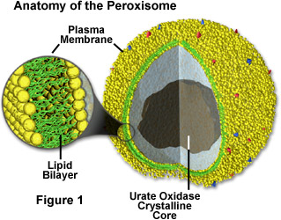
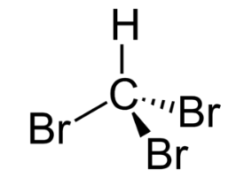
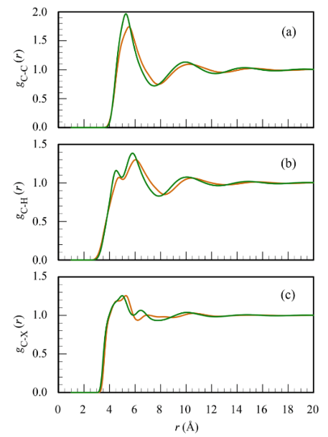
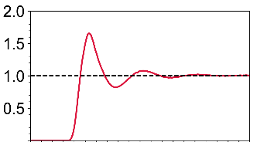
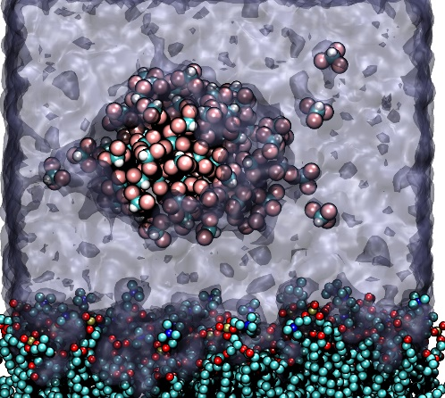
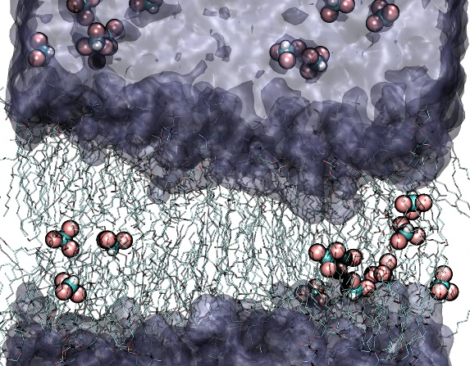
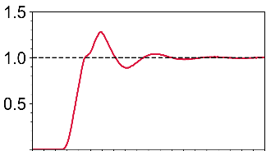
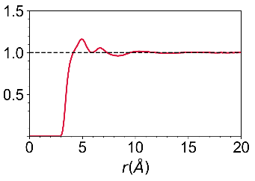
Using Computational Physics to Tackle Climate Change (Project 1 of 2)
Kevin J. Cheng, Taras Pogorelov, Sara Capponi
Problem: Methane Emission Increases Global Warming
Methodology: Molecular Dynamics Simulations
Bromoform 0.6M
Simulation at 1 atm, 303K, (NPT ensemble)
POPC Bilayer
Water
Experiment
MD Results
Results: Aggregation and Penetration Observed
0.6M
10 ns
0.2M
260ns
150 ns
Work supported by the NSF
Grant No. DBI-1548297
Kevin José Cheng / kevin.jose.cheng@ibm.com / kjcheng2@Illinois.edu
Concentration 0.6M
Notes:
Methan from Cattle

Slide 7












Studying Protein-Protein Interaction For Engineering Signaling pathways Using MD and AI (Project 2 of 2)
Kevin J. Cheng, Taras Pogorelov, Sara Capponi
Problem: What are the differences in Wnt Signaling pathways?
Methodology: Molecular Dynamics Simulations
Biochemical Journey of Wnt
PDB ID: 7KC4
Wnt3a
1.5µs
Wnt8a
1.5µs
Building a ML model to predict Binding Properties of Other Wnts
Serine-Palmitoleate Paramaterization
Work supported by the NSF
Grant No. DBI-1548297
Kevin José Cheng / kevin.jose.cheng@ibm.com / kjcheng2@Illinois.edu
Concentration 0.6M
Notes:
Methan from Cattle

Slide 8

Determining the Synthetic Lethality of Cancer Related Mutations with Methyl ad Ethyl Paraben in Drosophila melanogaster

Slide 9


Slide 10


DECIPHER: Deconstructing Cell-cell Interactions using Phenotypic Heterogeneity in scRNA-seq data
Hypothesis: we can use variation in scRNAseq data to identify distinct tissue
states where different cell types are behaving in a coordinated way
Murrow…Phong, Rabadam et al., Cell Systems 2022

Slide 11




Integrated whole-cell modeling of subcellular organization and organelle interactions in Saccharomyces cerevisiae
Mary Mirvis
Wallace Marshall lab, Dept. of Biochemistry & Biophysics, UCSF
Spherical Harmonics-based integrated statistical modeling of cell & organelle shape (Allen Institute)
High-resolution multi-organelle 3D imaging :
Soft X-ray Tomography
WT
vac14Δ – large vacuole
1μm
WT
Cell / DAPI / Vac
Cell / Nuc / Vac / LD
St.dev +1
vac14Δ
Mean
Cell
Nuc
Vac
LD
Vac:Cyto <0.3 R² = 0.0306
Vac:Cyto >0.3 R² = 0.2137
Vac:Cyto >0.5 R² = 0.3256
St.dev -1
Notes:
In Wallace Marshall’s lab we are interested in questions of cellular geometry, and in my postdoc work I am focusing on the geometry of subcellular organization on the mesoscale. Using a combination of spherical harmonics shape modeling and high-resolution Soft-X-ray tomography in yeast, my goal is to generate a statistical representation of typical cellular organization, identifying constrained and variable features of organelle morphology, positioning, and spatial interactions/relationships. I’m particularly interested in characterizing coupled morphological changes in interacting organelles between wild-type and mutant strains, such as enlarged vacuole mutants which we hypothesize introduce space constraints on other organelles. This work will lead to new insights into how physical interdependencies between organelles help pattern the cell.

