Slide 1
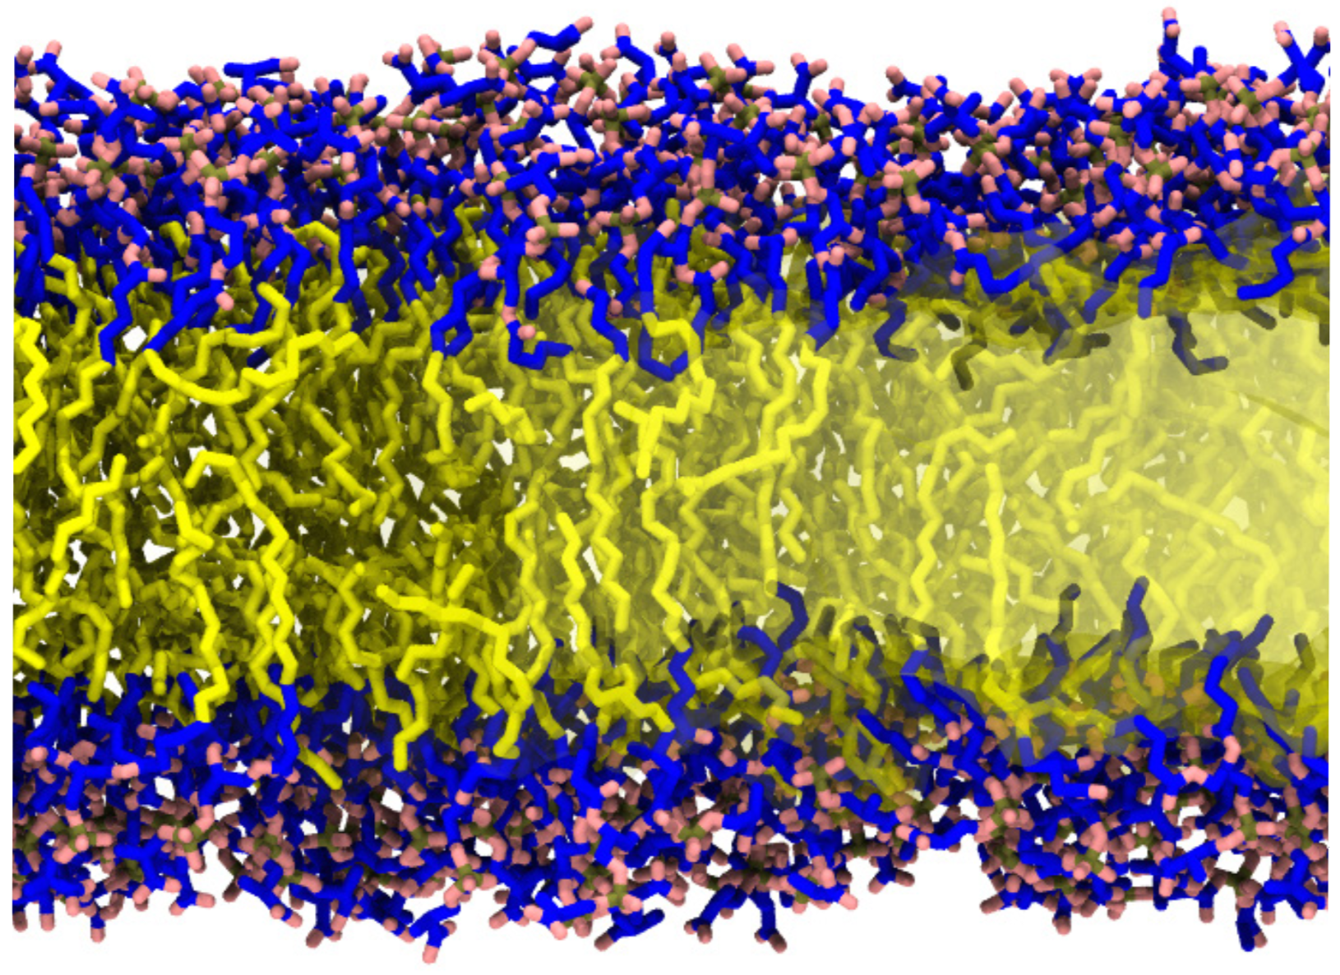
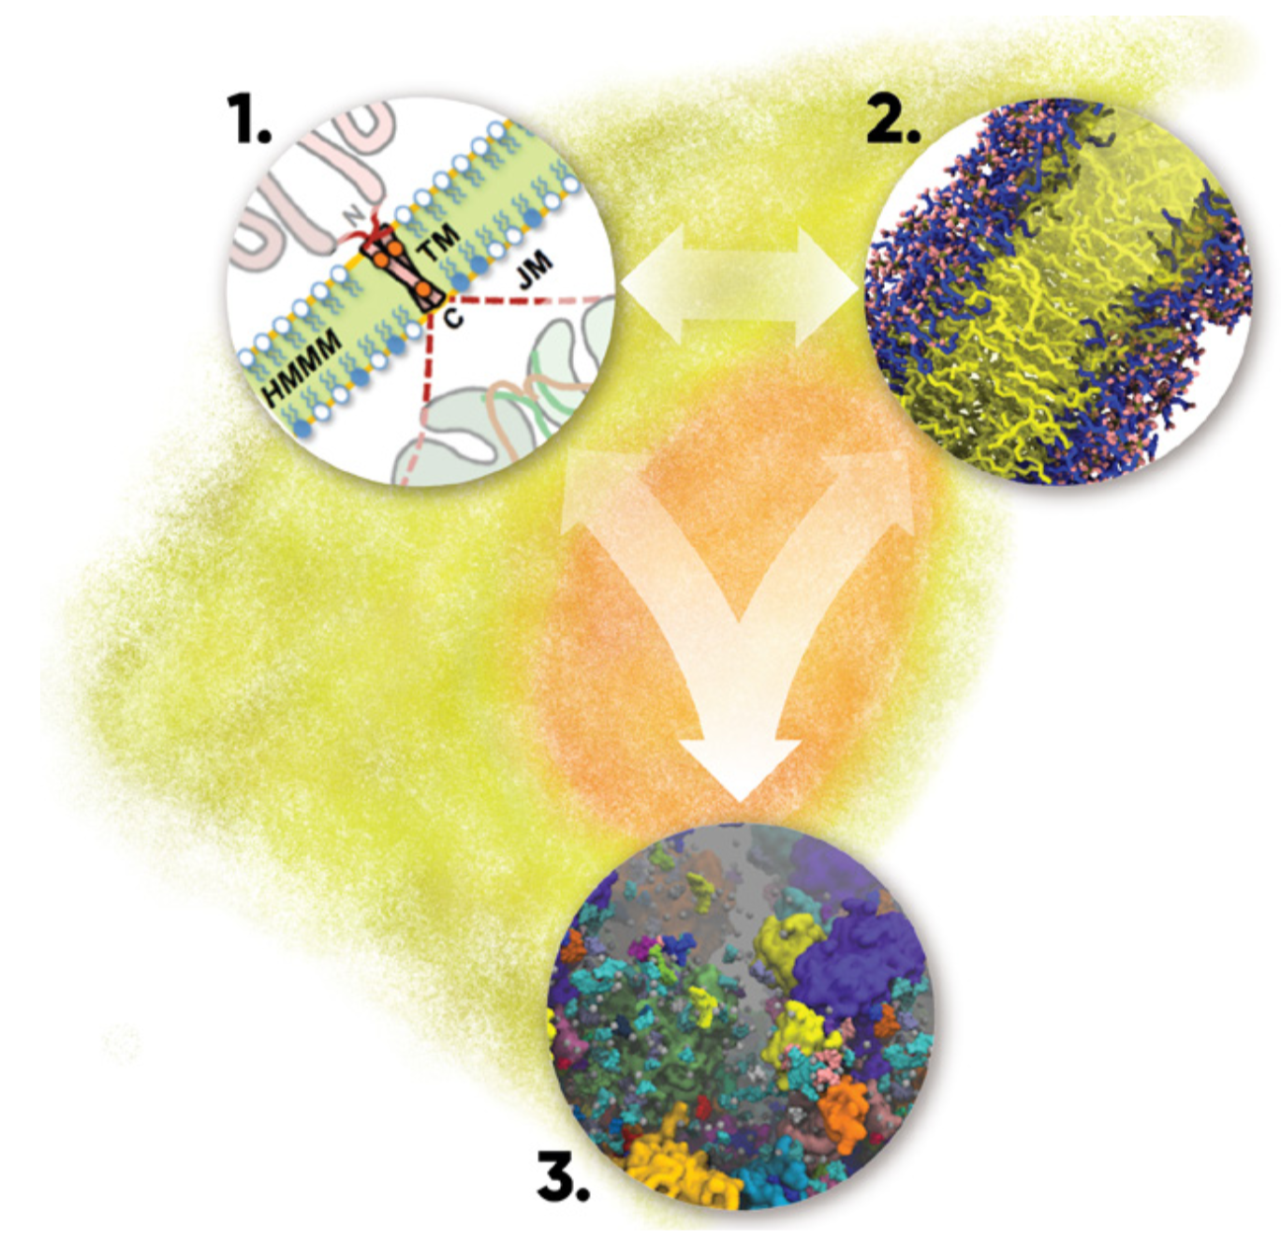
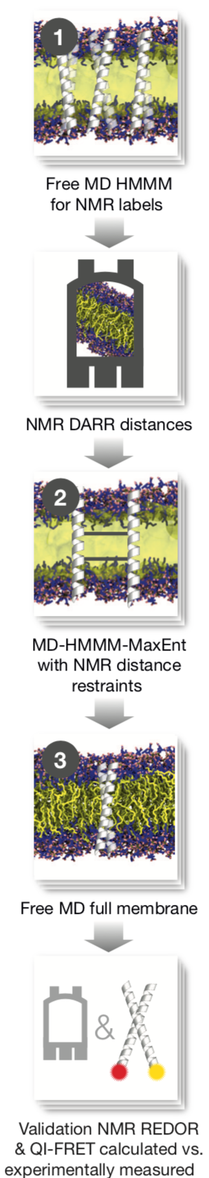
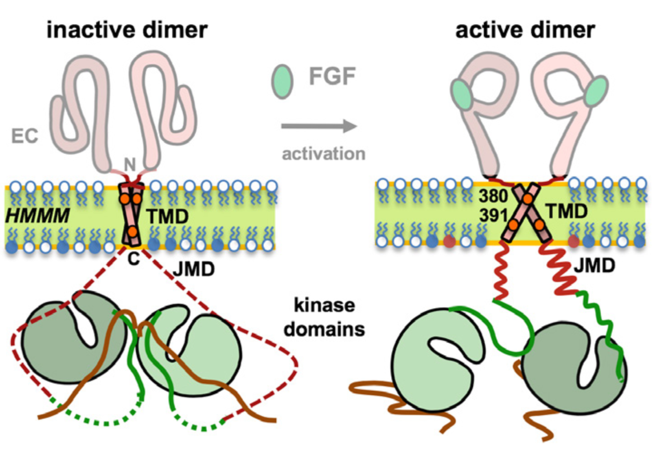
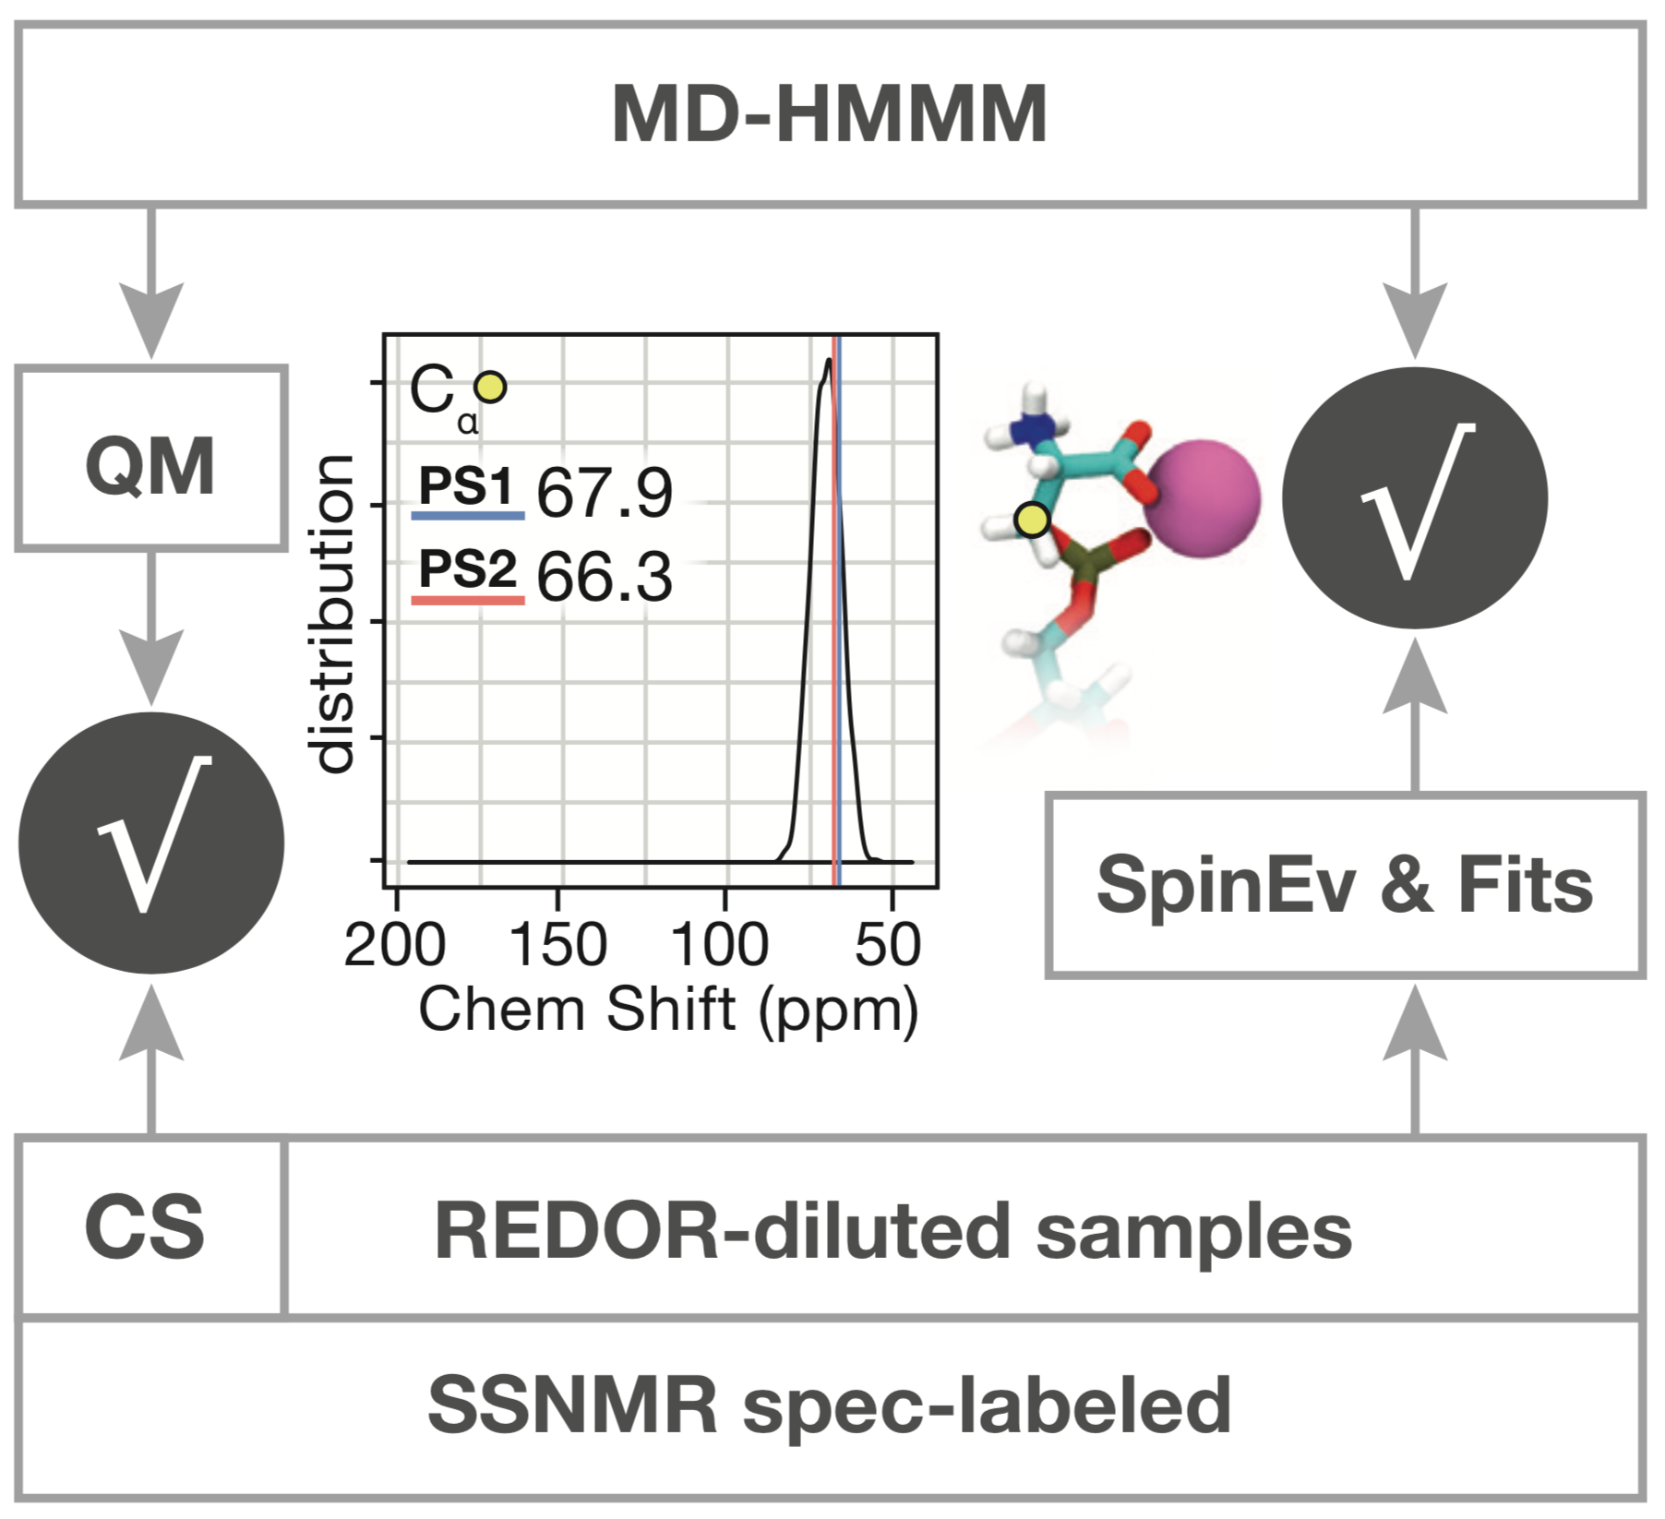
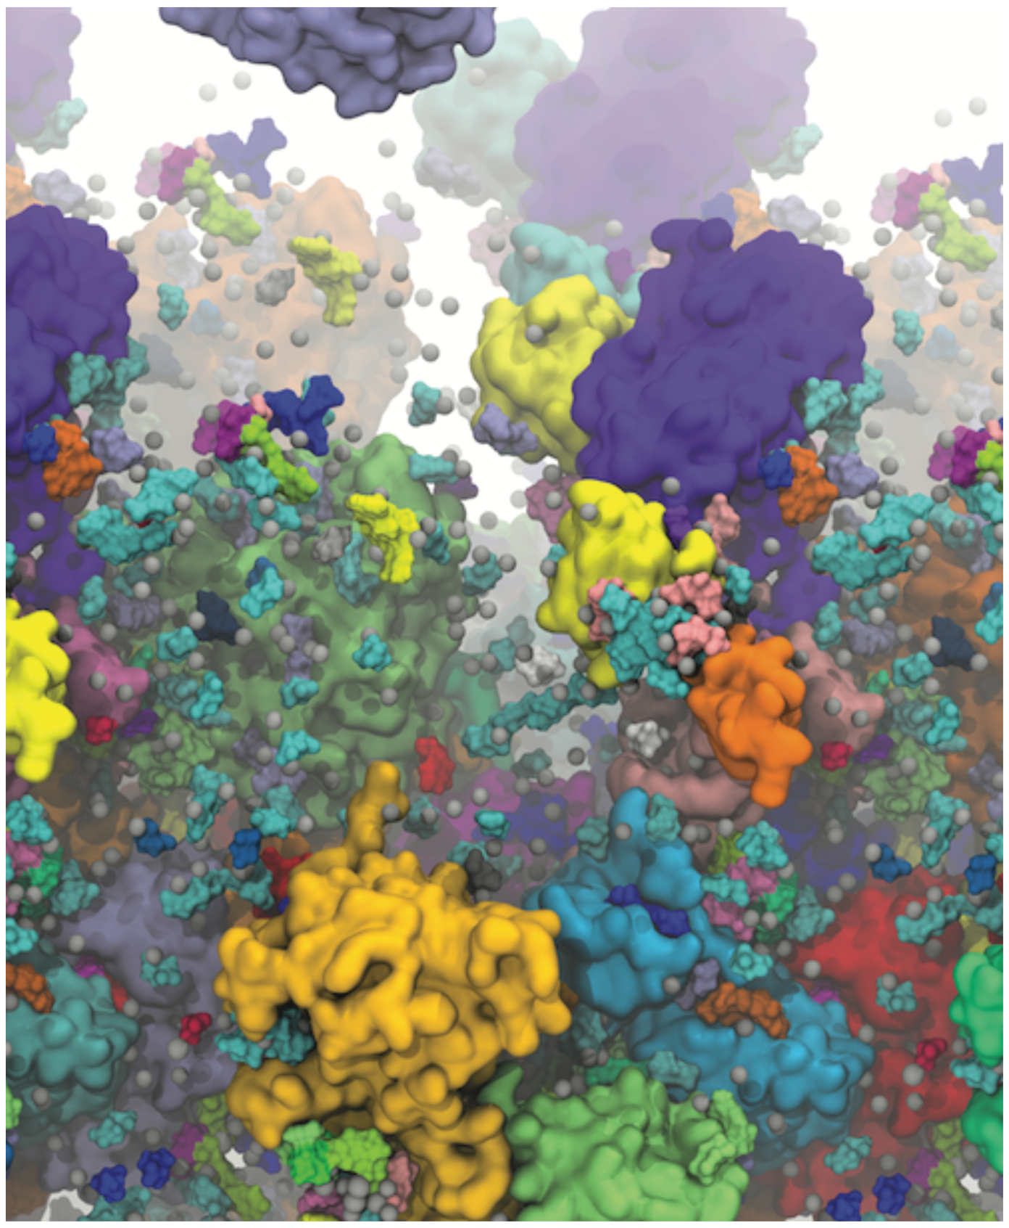
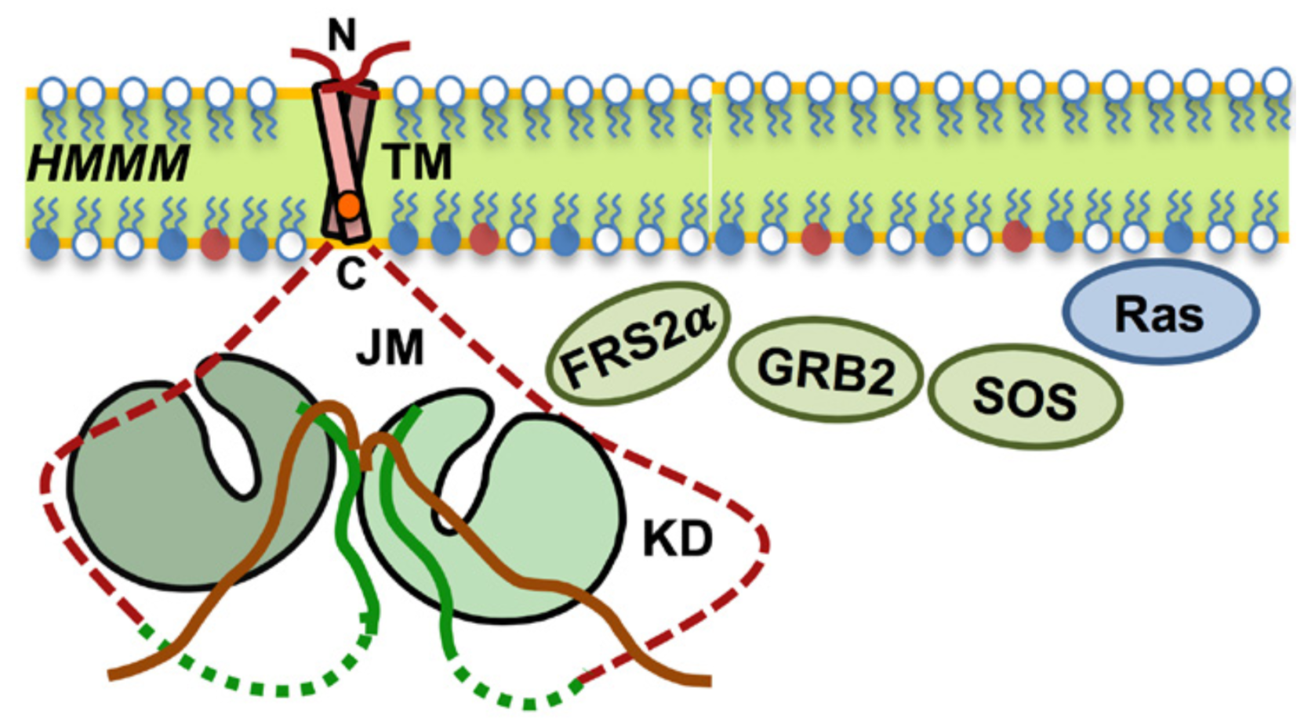

POGORELOV LAB
MOLECULAR INFORMATION TRANSFER IN THE CELL
2. CELL MEMBRANES: FUNCTIONAL LIPIDS AND MEMBRANE-ACTIVE AGENTS
1.TRANSMEMBRANE SIGNALING IN HEALTH AND DISEASE
3. IN SILICO CELL ENVIRONMENT: PROTEIN DYNAMICS AND SIGNALING
Experimental Collaborations
Marty Burke (UIUC) – Organic Chem
Martin Gruebele (UIUC) - Spectroscopy
Kalina Hristova (JHU) - FRET
Jim Morrissey (Michigan) - Biochemistry
Lisa Olshansky (UIUC) – Inorganic Chem
Chad Rienstra (Wisconsin) - NMR
Tatyana & Alex Smirnov (NC State) - EPR
Kai Zhang (UIUC) – Optogenetics
Funding
NIH R01-GM141298
@TarasPogorelov
http://pogorelov.scs.illinois.edu

